Slide 1

Task 1
Web scraping to gain company insights

Slide 2
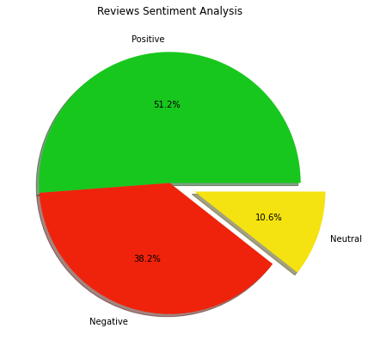
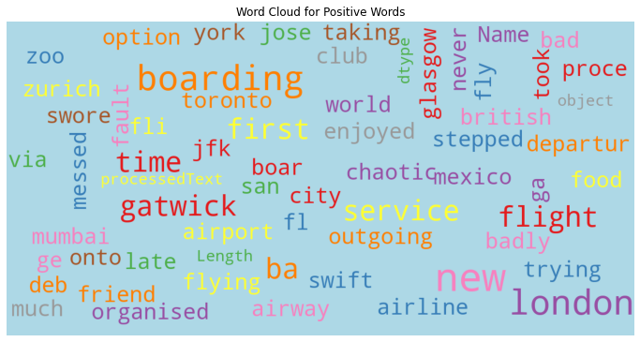
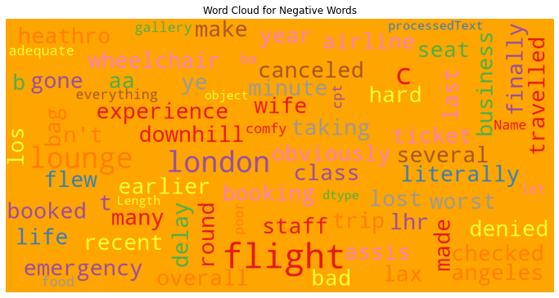
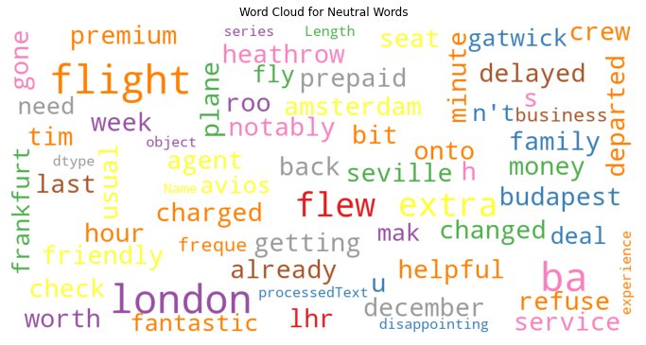
From analysing 1000 reviews of British Airways, we can observe the following: Positive Reviews: 512 (51.2%) Negative Reviews 382 (38.2%) Neutral Reviews: 106 (10.6%) Most of the reviews are positive but still there are quite large number of negative reviews. We should connect/engage with the individuals giving negative reviews and ask them what can we do better to help them. We should find the item in the review text which is getting the most number of negative review should target it first and so on.

